Slide 1
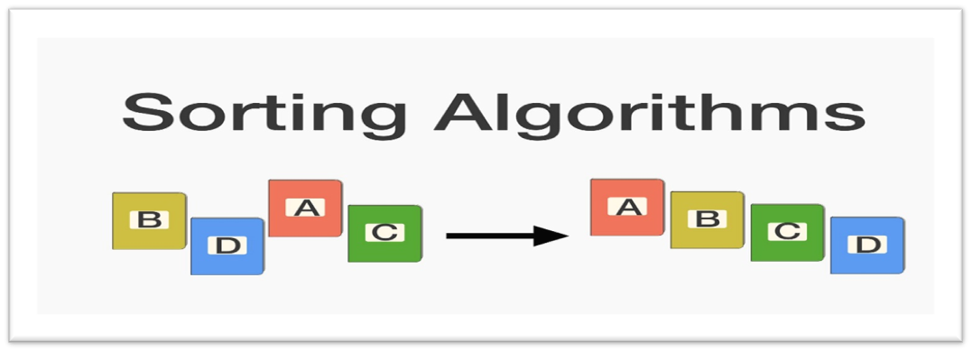
CSE214: Algorithms
Sorting Algorithms

Slide 2
Today’s Contents
Sorting Algorithms
Why Sorting Algorithms?
Types of Sorting Algorithms
Selection Sort
Insertion Sort
Complexity Analysis
Questions for You!

Slide 3
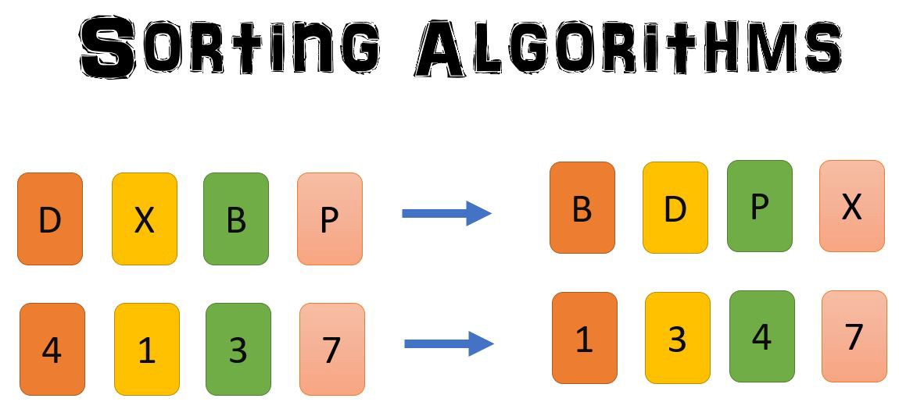
Sorting Algorithms
Sorting refers to arranging data in a particular format.
Most common orders are in numerical or lexicographical order.

Slide 4
Why Sorting Algorithms
The importance of sorting lies in the fact that data searching can be optimized to a very high level, if data is stored in a sorted manner.
Sorting is also used to represent data in more readable formats.
Following are some of the examples of sorting in real-life scenarios −
    Telephone Directory
    Dictionary

Slide 5
Types of Sorting Algorithms
In-place Sorting and Not-in-place Sorting
Sorting algorithms may require some extra space for comparison and temporary storage of few data elements. These algorithms do not require any extra space and sorting is said to happen in-place, or for example, within the array itself. This is called in-place sorting.
Bubble sort, Selection Sort, insertion sort are some examples of in- place sorting.
However, in some sorting algorithms, the program requires space which is more than or equal to the elements being sorted. Sorting which uses equal or more space is called not-in-place sorting.
Merge-sort is an example of not-in-place sorting.

Slide 6
In this Course, we will Learn
Selection Sort
Insertion Sort
Merge Sort
Quick Sort

Slide 7
1. Selection Sort
The selection sort algorithm sorts an array by repeatedly finding the minimum element (considering ascending order) from unsorted part and putting it at the beginning.
Idea:
  Find the smallest element in the array
  Exchange it with the element in the first position
  Find the second smallest element and exchange it with the element in the second position
  Continue until the array is sorted

Slide 8
How Selection Sort works
8
4
6
9
2
3
1
1
2
3
4
9
6
8
1
4
6
9
2
3
8
1
2
3
4
6
9
8
1
2
6
9
4
3
8
1
2
3
4
6
8
9
1
2
3
9
4
6
8
1
2
3
4
6
8
9

Slide 9
Algorithm of Selection Sort
SELECTION-SORT(A)
n ← length[A]
for i ← 1 to n - 1
min ← i
for j ← i + 1 to n
if A[j] < A[min]
min ← j
exchange A[i] ↔ A[min]

Slide 10
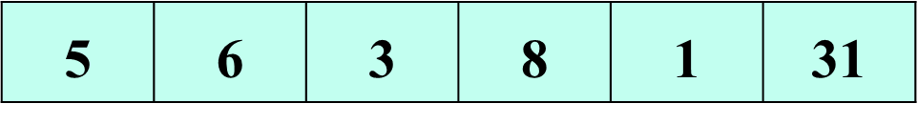
Exercise - 1: Sort the Array with selection Sort

Slide 11
Algorithm of Selection Sort
SELECTION-SORT(A)
n ← length[A]
for i ← 1 to n - 1
for j ← i + 1 to n
if A[j] < A[i]
exchange A[i] ↔ A[j]
  Complexity:
  Worst Case:
  Best Case:
  Average Case:

Slide 12
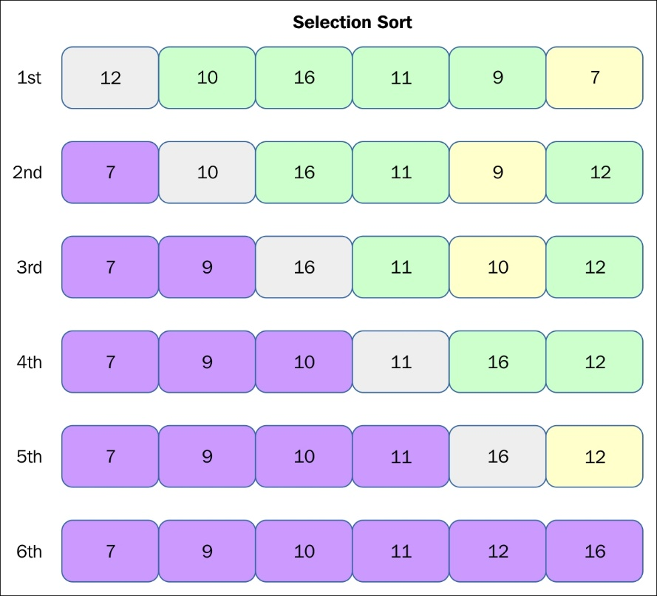

Slide 13
Time Complexity
Sorted List
Worst Case: O(n²)
Best Case: O(n²)
Average Case: O(n²)
2 | 3 | 4 | 5
Unsorted List
5 | 4 | 2 | 3

Slide 14
2. Insertion Sort
The array is searched sequentially and unsorted items are moved and inserted into the sorted sub-list (in the same array).

Slide 15
Idea: like sorting a hand of playing cards
Start with an empty left hand and the cards facing down on the table.
Remove one card at a time from the table, and insert it into the correct position in the left hand
compare it with each of the cards already in the hand, from right to left
The cards held in the left hand are sorted
these cards were originally the top cards of the pile on the table

Slide 16
How Insertion Sort works
To insert 12, we need to make room for it by moving first 36 and then 24.
6
10
24
36
12

Slide 17
How Insertion Sort works
6
10
24
36
12

Slide 18
How Insertion Sort works
6
10
24
36
12

Slide 19
How Insertion Sort works
6
10
12
24
36
Cards are sorted

Slide 20
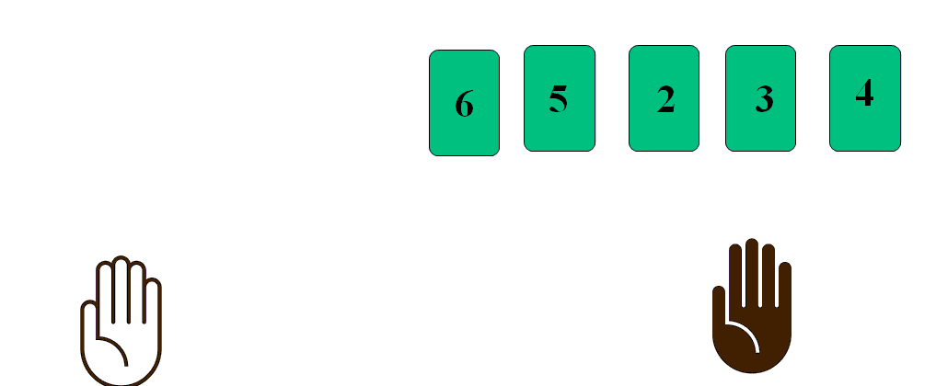
How Insertion Sort works
6
5
2
3
4

Slide 21
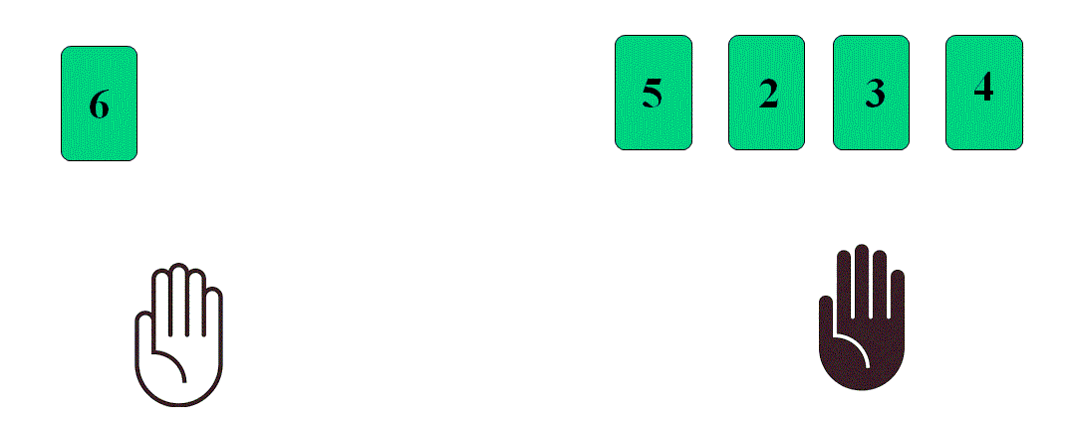
How Insertion Sort works

Slide 22
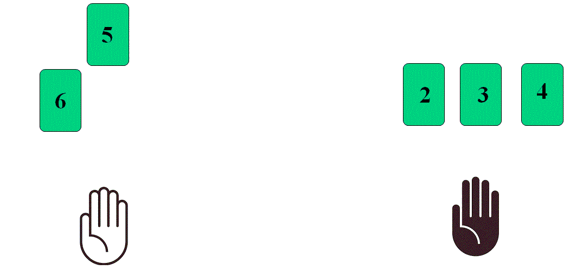
How Insertion Sort works

Slide 23
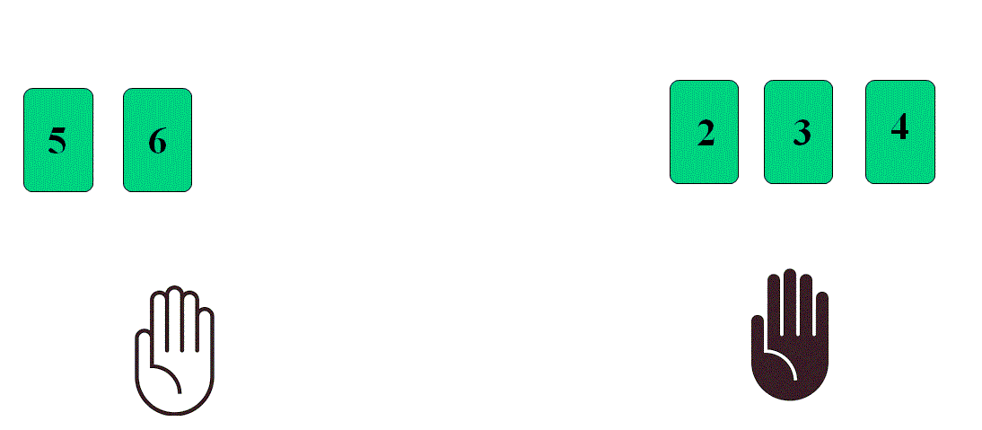
How Insertion Sort works

Slide 24
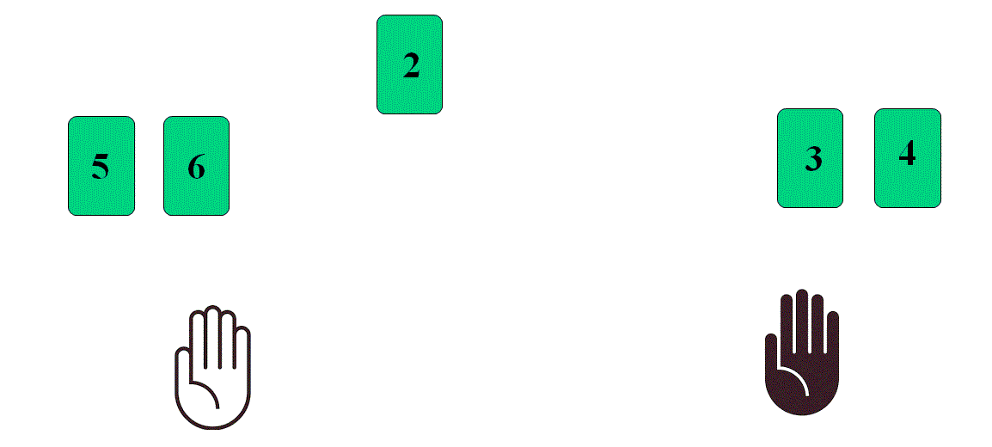
How Insertion Sort works

Slide 25
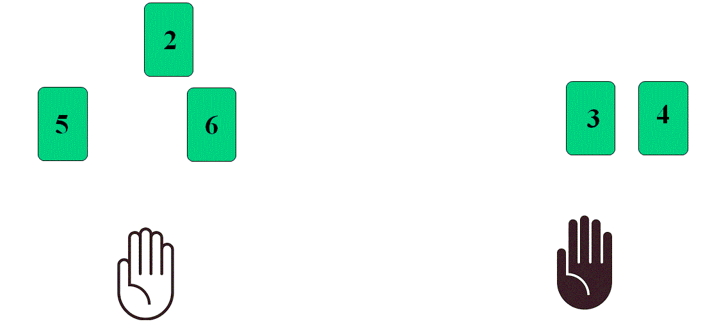
How Insertion Sort works

Slide 26
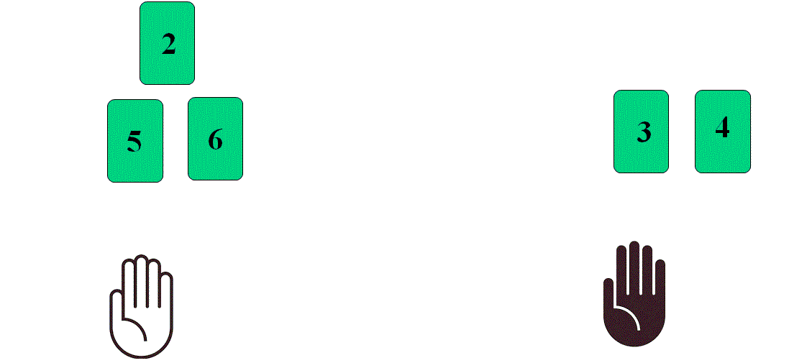
How Insertion Sort works

Slide 27
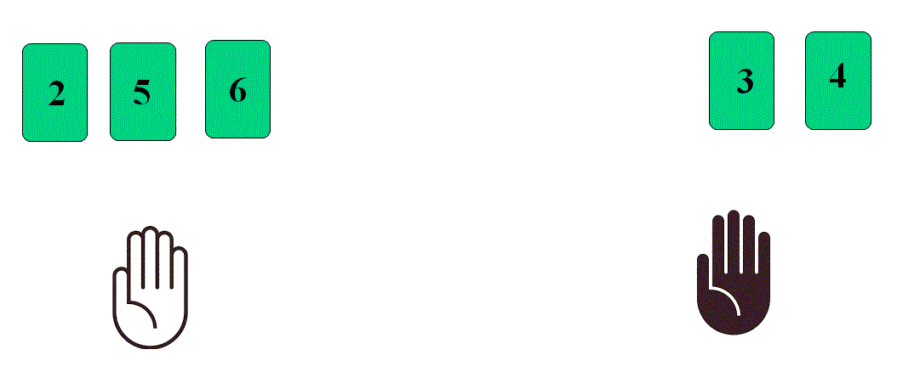
How Insertion Sort works

Slide 28
Example
5 | 4 | 7 | 8 | 2 | 6

Slide 29
Example
5 | 4 | 7 | 8 | 2 | 6

Slide 30
Example
5 | 4 | 7 | 8 | 2 | 6
Key = 4

Slide 31
Example
5 | 5 | 7 | 8 | 2 | 6
Key = 4

Slide 32
Example
5 | 4 | 7 | 8 | 2 | 6
Key = 4
Pass - 1
4 | 5 | 7 | 8 | 2 | 6

Slide 33
Example
5 | 4 | 7 | 8 | 2 | 6
Key = 4
Pass - 1
4 | 5 | 7 | 8 | 2 | 6
Key = 7

Slide 34
Example
5 | 4 | 7 | 8 | 2 | 6
Key = 4
Pass - 1
4 | 5 | 7 | 8 | 2 | 6
Key = 7
Pass - 2
4 | 5 | 7 | 8 | 2 | 6

Slide 35
Example
5 | 4 | 7 | 8 | 2 | 6
Key = 4
Pass - 1
4 | 5 | 7 | 8 | 2 | 6
Key = 7
Pass - 2
4 | 5 | 7 | 8 | 2 | 6
Key = 8

Slide 36
Example
5 | 4 | 7 | 8 | 2 | 6
Key = 4
Pass - 1
4 | 5 | 7 | 8 | 2 | 6
Key = 7
Pass - 2
4 | 5 | 7 | 8 | 2 | 6
Key = 8
Pass - 3
4 | 5 | 7 | 8 | 2 | 6

Slide 37
Example
5 | 4 | 7 | 8 | 2 | 6
Key = 4
Pass - 1
4 | 5 | 7 | 8 | 2 | 6
Key = 7
Pass - 2
4 | 5 | 7 | 8 | 2 | 6
Key = 8
Pass - 3
4 | 5 | 7 | 8 | 2 | 6
Key = 2

Slide 38
Example
5 | 4 | 7 | 8 | 2 | 6
Key = 4
Pass - 1
4 | 5 | 7 | 8 | 2 | 6
Key = 7
Pass - 2
4 | 5 | 7 | 8 | 2 | 6
Key = 8
Pass - 3
4 | 5 | 7 | 8 | 8 | 6
Key = 2

Slide 39
Example
5 | 4 | 7 | 8 | 2 | 6
Key = 4
Pass - 1
4 | 5 | 7 | 8 | 2 | 6
Key = 7
Pass - 2
4 | 5 | 7 | 8 | 2 | 6
Key = 8
Pass - 3
4 | 5 | 7 | 7 | 8 | 6
Key = 2

Slide 40
Example
5 | 4 | 7 | 8 | 2 | 6
Key = 4
Pass - 1
4 | 5 | 7 | 8 | 2 | 6
Key = 7
Pass - 2
4 | 5 | 7 | 8 | 2 | 6
Key = 8
Pass - 3
4 | 5 | 5 | 7 | 8 | 6
Key = 2

Slide 41
Example
5 | 4 | 7 | 8 | 2 | 6
Key = 4
Pass - 1
4 | 5 | 7 | 8 | 2 | 6
Key = 7
Pass - 2
4 | 5 | 7 | 8 | 2 | 6
Key = 8
Pass - 3
4 | 4 | 5 | 7 | 8 | 6
Key = 2

Slide 42
Example
5 | 4 | 7 | 8 | 2 | 6
Key = 4
Pass - 1
4 | 5 | 7 | 8 | 2 | 6
Key = 7
Pass - 2
4 | 5 | 7 | 8 | 2 | 6
Key = 8
Pass - 3
4 | 5 | 7 | 8 | 2 | 6
Key = 2
Pass - 4
2 | 4 | 5 | 7 | 8 | 6

Slide 43
Example
5 | 4 | 7 | 8 | 2 | 6
Key = 4
Pass - 1
4 | 5 | 7 | 8 | 2 | 6
Key = 7
Pass - 2
4 | 5 | 7 | 8 | 2 | 6
Key = 8
Pass - 3
4 | 5 | 7 | 8 | 2 | 6
Key = 2
Pass - 4
2 | 4 | 5 | 7 | 8 | 6

Slide 44
Example
5 | 4 | 7 | 8 | 2 | 6
Key = 4
Pass - 1
4 | 5 | 7 | 8 | 2 | 6
Key = 7
Pass - 2
4 | 5 | 7 | 8 | 2 | 6
Key = 8
Pass - 3
4 | 5 | 7 | 8 | 2 | 6
Key = 2
Pass - 4
2 | 4 | 5 | 7 | 8 | 6
Key = 6

Slide 45
Example
5 | 4 | 7 | 8 | 2 | 6
Key = 4
Pass - 1
4 | 5 | 7 | 8 | 2 | 6
Key = 7
Pass - 2
4 | 5 | 7 | 8 | 2 | 6
Key = 8
Pass - 3
4 | 5 | 7 | 8 | 2 | 6
Key = 2
Pass - 4
2 | 4 | 5 | 7 | 8 | 8
Key = 6

Slide 46
Example
5 | 4 | 7 | 8 | 2 | 6
Key = 4
Pass - 1
4 | 5 | 7 | 8 | 2 | 6
Key = 7
Pass - 2
4 | 5 | 7 | 8 | 2 | 6
Key = 8
Pass - 3
4 | 5 | 7 | 8 | 2 | 6
Key = 2
Pass - 4
2 | 4 | 5 | 7 | 7 | 8
Key = 6

Slide 47
Example
5 | 4 | 7 | 8 | 2 | 6
Key = 4
Pass - 1
4 | 5 | 7 | 8 | 2 | 6
Key = 7
Pass - 2
4 | 5 | 7 | 8 | 2 | 6
Key = 8
Pass - 3
4 | 5 | 7 | 8 | 2 | 6
Key = 2
Pass - 4
2 | 4 | 5 | 7 | 7 | 8
Key = 6
Pass - 5
2 | 4 | 5 | 6 | 7 | 8

Slide 48
Example
5 | 4 | 7 | 8 | 2 | 6
Key = 4
Pass - 1
4 | 5 | 7 | 8 | 2 | 6
Key = 7
Pass - 2
4 | 5 | 7 | 8 | 2 | 6
Key = 8
Pass - 3
4 | 5 | 7 | 8 | 2 | 6
Key = 2
Pass - 4
2 | 4 | 5 | 7 | 8 | 6
Key = 6
Pass - 5
2 | 4 | 5 | 6 | 7 | 8
Sorted

Slide 49
Algorithm of Insertion Sort
InsertionSort (A)
{
for j = 2 to length(A)
key = A[j]
i = j - 1
while ( i > 0 && A[ i ] > key )
{
A[i+1] = A[i]
i = i -1
}
A[i + 1] = key
}
Key = A[j]
i
j
5 | 4 | 2 | 3
Key = 4
4 | 5 | 2 | 3
Key =
2 | 4 | 5 | 3
Key =
2 | 3 | 4 | 5
Sorted

Slide 50
Time Complexity
InsertionSort (A)
{
for j = 2 to length(A)
key = A[i]
i = j - 1
while ( i > 0 and A [ i ] > key )
{
A[i+1] = A[i]
i = i -1
}
A[i + 1] = key
}
Worst Case:
Best Case:
O(n²)
O(n)
Sorted List
2 | 3 | 4 | 5
Unsorted List
5 | 4 | 2 | 3

Slide 51
Complexity Analysis of Two Algorithms
Algorithm | Best case | Worst case
Selection Sort | O(n²) | O(n²)
Insertion Sort | O(n) | O(n²)

Slide 52
Question for you
Which Algorithm will you choose?
2. Sort the given data set using both the Selection Sort and Insertion Sort. Show each steps.
10 | 26 | 13 | 6 | 8 | 20 | 22 | 13

Slide 53
Some References
https://visualgo.net/en/sorting

Slide 54



